Slide 1

Let’s talk about …
News Writing
By Jeanne Acton, UIL & ILPC Journalism Director

Slide 2
News Writing …
gives the reader information that will impact them in some way. It usually flows from most important to least important.
“What is news? It is information only.” - Walter Cronkite, former CBS News anchor

Slide 3
Checklist for News Stories
Are the most important and recent facts first?
Is the story accurate? Are the sources identified fully?
Are the paragraphs short?
Is the sentence structure varied in the story?
Is the story neat and double-spaced so that it is easy to read?
Does your story flow? Did you use the transition/quote formula?
Did you use active voice?

Slide 4
Pitfalls to Avoid
Editorializing - Keep your opinion out of the story
Using first and second person - Keep yourself out of the story. Common error “our school”
Missing the news peg
Messy handwriting, poor grammar and spelling
Paragraphs too long
Misspelling names in the story
Trying to use all of the information

Slide 5
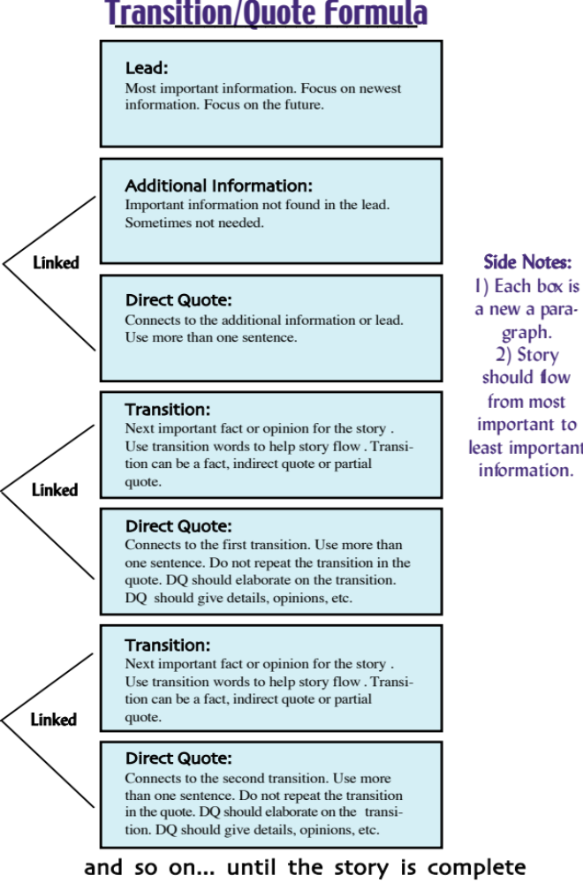

Slide 6
Let’s start at the beginning with … LEADS.

Slide 7

Let’s talk about
Leads

Slide 8
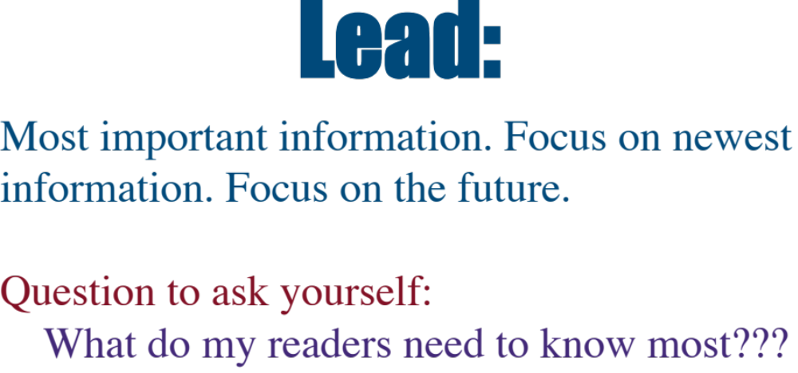

Slide 9
Leads
Most straight news leads should be summary leads. That means they summarize the 5 Ws and H of the story, starting off with the most important W or H.

Slide 10
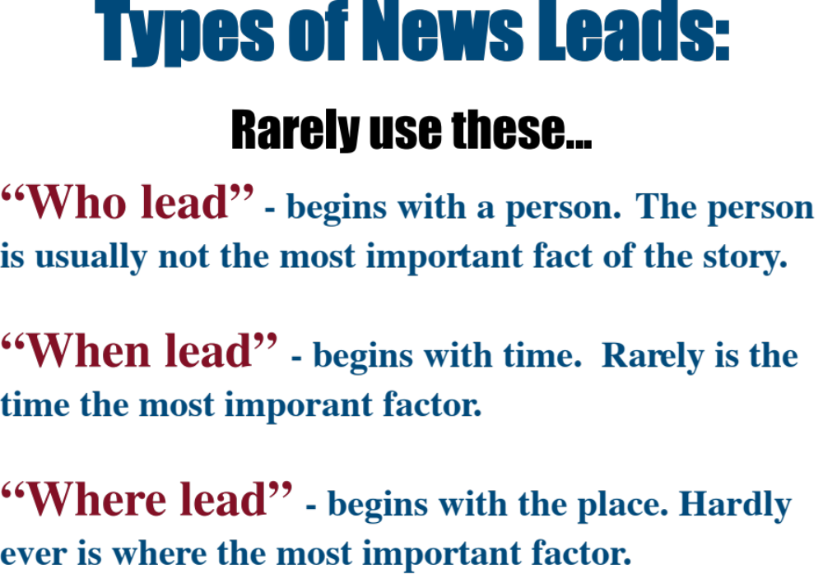

Slide 11
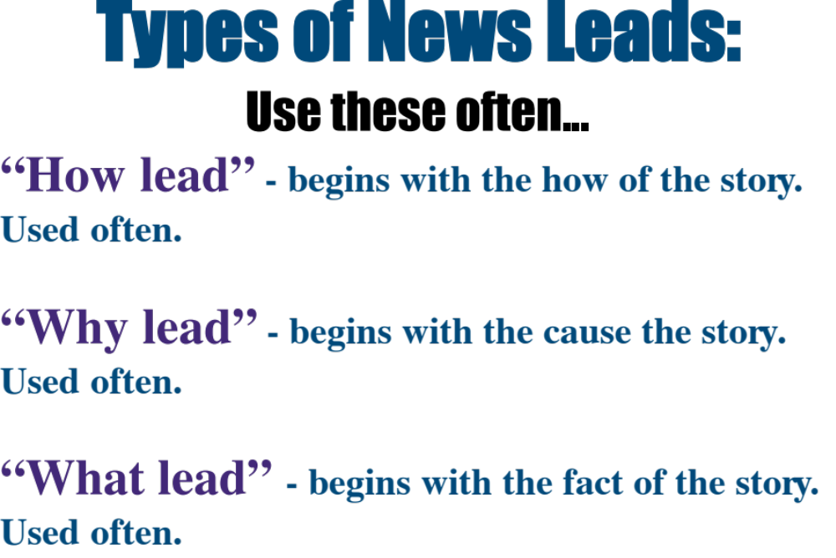

Slide 12

Who lead
Not so good…
Principal Joe Blow announced Tuesday that students will no longer be allowed to leave campus for lunch due to excessive tardies.
Better…
President Barack Obama will make a brief appearance at the high school Thursday after giving a speech at the County Expo Center.

Slide 13
When lead
Not so good…
On Tuesday Principal Joe Blow announced that students will no longer be able to leave campus for lunch.
Better…
On Saturday President Barack Obama will speak to the senior class about how important community organizing and volunteering are to the country.

Slide 14
Where lead
Avoid where leads
At the school board meeting on Tuesday, Principal Joe Blow announced that he has ended the off-campus lunch policy.
Maybe … probably yes.
In the principal’s office, the senior class dumped 30 pounds of sand to protest the cancellation of the senior trip to Cancun.

Slide 15
How lead
Through a grass roots voting effort, senior Gilbert Castillo won the mayoral election to become the youngest mayor in the city’s history.

Slide 16
Why lead
Because they wanted to carry on the tradition, four seniors streaked across the football stadium during the homecoming pep rally wearing a paper leis and tennis shoes.

Slide 17
What lead
The Harry Potter series and Lord of the Rings series will be removed from all school libraries this fall.

Slide 18
Now that we know the type of lead we are looking for, how do we write a good lead?
• read the entire prompt
• find the newest information in the prompt
• beware of older, more controversial news
• write one to two sentences summarizing the “new” news including as many other Ws and H as possible

Slide 19
Let’s talk about
Direct
Quotes

Slide 20
Direct Quotes:
Should be linked to the transition/lead before them. The quote should elaborate on the transition.
  For example:
  President Barack Obama will make a brief appearance at the high school Thursday after giving a speech at the County Expo Center.
  “He is coming as a favor to me,” Principal Ike Sumter said. “We worked together in Chicago as community organizers. I hope he gets a chance to speak to some seniors about what they can do for their country.”

Slide 21
Direct Quotes:
Should not repeat the transition/lead before them.
  For example:
  President Barack Obama will make a brief appearance at the high school Thursday after giving a speech at the County Expo Center.
  “ After speaking at the Expo Center, the candidate will come to the high school for a short appearance,” Principal Ike Sumter said.

Slide 22
Direct Quotes:
Can be longer than one sentence.
Should have attribution after the first sentence of the quote.
Attribution should be: Noun then verb.
For example:
Correct - senior Bob Rodriguez said.
Incorrect - said senior Bob Rodriguez.
(unless you have an unusually long title)
Do not place two people’s direct quotes next to each other without a transition.

Slide 23
Let’s talk about
Transitions

Slide 24
Transitions
VERY, VERY IMPORTANT. Hold the story together. Link the paragraphs together.
Can be fact, indirect quote or a partial quote.
  For example - FACT TRANSITION:
  (lead) Former Republican presidential candidate John McCain will speak to seniors Friday about his experience as a prisoner of war.
  (Direct Quote)“Seniors will learn a lot about duty and commitment when they hear Sen. McCain,” Principal Ike Sumter said. “We are so excited that he agreed to come.” (Fact Transition) During the Vietnam War, Sen. McCain was a prisoner of war for five years.

Slide 25
Transitions
Can be fact, indirect quote or a partial quote.
  For example - INDIRECT QUOTE TRANSITION:
  (lead) Former Republican presidential candidate John McCain will speak to seniors Friday about his experience as a prisoner of war.
  (Direct Quote)“Seniors will learn a lot about duty and commitment when they hear Sen. McCain,” Principal Ike Sumter said. “We are so excited that he agreed to come.”
  (IQ Transition) Sumter said he was moved after hearing Sen. McCain speak about his imprisonment.

Slide 26
Transitions
Can be fact, indirect quote or a partial quote.
  For example - PARTIAL QUOTE TRANSITION:
  (lead)Former Republican presidential candidate John McCain will speak to seniors Friday about his experience as a prisoner of war.
  (Direct Quote)“Seniors will learn a lot about duty and commitment when they hear Sen. McCain,” Principal Ike Sumter said. “We are so excited that he agreed to come.”
  (Partial Quote Transition) Sumter said he “had tears in his eyes” when he heard Sen. McCain speak about his imprisonment.

Slide 27
What comes next??
  (lead)Former Republican presidential candidate John McCain will speak to seniors Friday about his experience as a prisoner of war.
  (Direct Quote)“Seniors will learn a lot about duty and commitment when they hear Sen. McCain,” Principal Ike Sumter said. “We are so excited that he agreed to come.”
  (Partial Quote Transition) Sumter said he “had tears in his eyes” when he heard Sen. McCain speak about his imprisonment.

Slide 28
The T/Q formula
  Sumter said he “had tears in his eyes” when he heard Sen. McCain speak about his imprisonment.
  “It is amazing what this man survived,” Sumter said. “He was tortured daily, but every day he told his fellow soldiers to hold their head high. Someone was coming for them.”
  Sen. McCain said the experience was a “living hell,” but he never gave up hope.
  “I knew I would make it back to American soil one day,” he said. “Hope is always alive, and that was part of my message as a presidential candidate, too.”

Slide 29
Transitions
Use transitional words to help with the flow (as needed): After all, Also, Finally, In addition, However, Otherwise, Then
For example:
In addition to speaking about his experience as a prisoner of war, McCain also plans to talk to students about the importance of voting.

Slide 30
Let’s Review …
What types of leads should you use more?
Following a transition, what should a direct quote do?
Where should you place the attribution for a direct quote?
What can a transition be?
What is the purpose of the transition?
How many sentences can a direct quote be?

Slide 31
What went wrong?
During the 2010-11 school year, our school has reported 22 fights so far. Last year, the school had 18 total fights.
“One of my friends got in a fight, but he didn’t start it. He was defending himself,” said freshman Andy Opel.
In response to the escalating fights, the school district hired the Teen Conflict Resolution Team to help students solve disagreements through non-violent solutions.
After March 23, any student caught fighting on campus must complete a TCRT non-violence workshop, in addition to normal disciplinary actions.
“Students have to learn how to solve life’s problems without violence, and this program will teach our students just that,” said Mr. Brown.
“Now students will get suspended and be forced to attend this program,” Opal said. “That’s just too much.”
Notes:
Lead not most recent.
spelling of opel
Full id of brown.
Quote attribution
When lead
Stacked quotes
Our in the lead

Slide 32
Prompt Activity
Read the entire prompt.
Review it again, looking for the newest information. Underline that information.
Highlight or underline the 5Ws and H.
Highlight or underline the most important people interviewed. Highlight or underline the most essential quotes.
Scratch out stupid, inane quotes.
Pay attention to the “Additional Information.”
Write your lead. How, why or what lead.

Slide 33
Prompt Activity
8. Write an additional info. paragraph if needed.
9. Use a direct quote (more than one sentence is okay).
10. Write a transition about the next most important thing.
11. Use a direct quote directly related to the transition above. If it’s an indirect quote transition, use a direct quote from that same person.
12. Write another transition about the next most important thing.
13. Another direct quote.
14. Keep going.

Slide 34

Let’s practice!
Follow the steps from “Prompt Activity”
Write as much as you can. Edit. Write. Edit.

